Slide 1




City of Niagara Falls
Trails and Active Transportation Master Plan Public Information Centre #3
MARCH 11, 2026

Slide 2


Community Guidelines
Please be respectful.​​
No tolerance for discrimination or hateful language of any kind.​​
Please send questions in the chat for the project team – we will look to answer at the end of each presentation. Our emails will be shared at the end of each presentation.
2

Slide 3
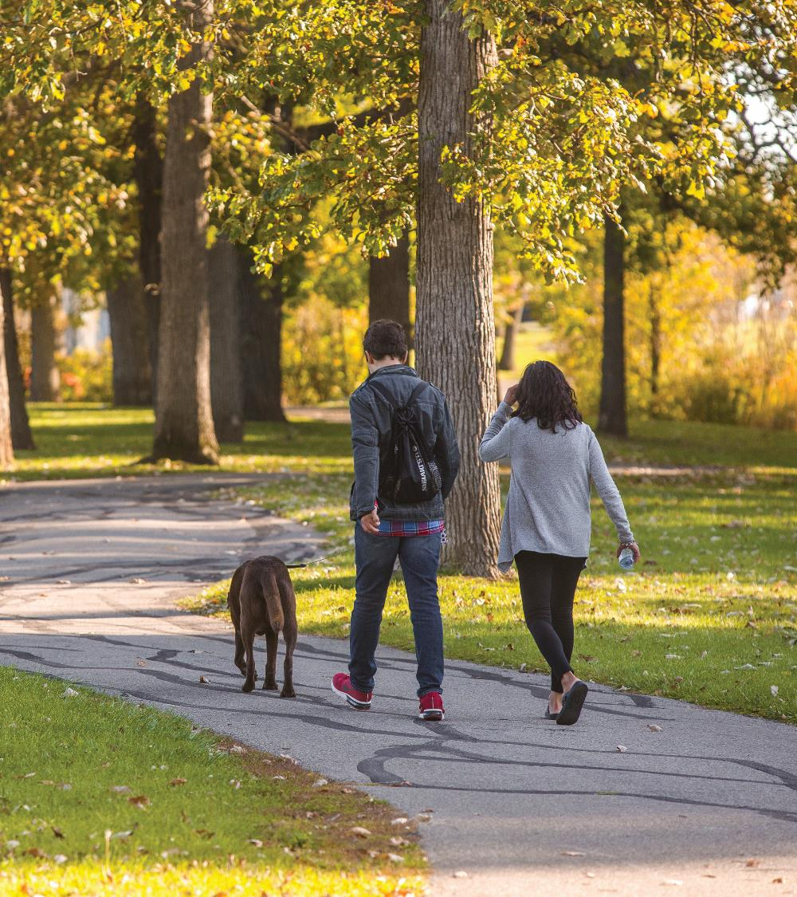

Agenda
Project Schedule Update
Draft Final Trails & Active Transportation Network
Policy and Strategy Recommendations
Programming and Education Recommendations
Monitoring & Reporting Program
3

Slide 4
Introductions
4

Slide 5
PROJECT SCHEDULE
Initiation & Background Review
Development of Active Transportation Network
Policies Framework and Programs
Implementation Strategies
Review of existing active transportation network and destinations
Development of vision and goals
Development of network hierarchy
Develop a draft network
Identify barriers and mitigation
Develop policies for maintenance, travel demand management, and wayfinding
Develop phasing and costing for network
Monitoring & Reporting Programs
Final TATMP
We are here
Monitoring program and strategies to ensure the successful implementation of the TATMP
5

Slide 6








TATMP Vision
A vision statement and Plan objectives reflect the key themes and guiding principles of the City of Niagara Falls’ current policy documents.
This will help to ensure that the Trails and Active Transportation Master Plan aligns with those previously approved statements in a clear manner.
As the project progresses, the vision statement may undergo revisions to further reflect the shared goals and aspirations of the City and its residents
“To cultivate a safe, connected, equitable, and accessible active transportation system that responds to the diverse needs of all users while supporting the local economy, encouraging and enhancing opportunities for active transportation, and ensuring connections to key destinations, contributing to a more vibrant, sustainable city.”
6

Slide 7






TATMP Objectives
Enhance the active transportation user experience by improving wayfinding, addressing active transportation network gaps, and ensuring a comfortable and attractive environment for active modes. ​
Integrate the TATMP and the TMP with other City initiatives and Regional strategic plans. ​
Develop an improvement and implementation plan that meets with the City’s capital programming schedule. ​
Ensure that the City staff have a monitoring program that allows for regular reporting of TATMP achievements and for adjustments to the implementation plan.​
In order to uphold the vision statement, actionable objectives have been formulated based on the City’s existing policy directives.
Design a safe, equitable and accessible active transportation system available to all.
Ensure a seamlessly connected network with linkages to areas of growth, transit, neighbouring municipalities, economic corridors and key destinations
7

Slide 8
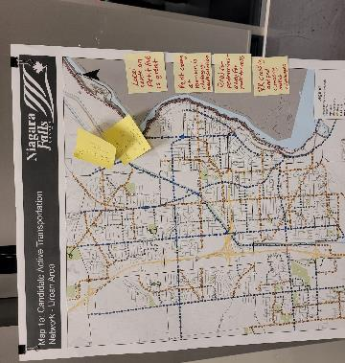
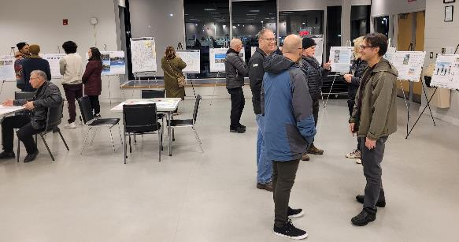
What We Heard (WWH)
Across both sessions, the project team walked the community through emerging findings, options for improving walking, cycling, transit, and road safety, and the draft active transportation network.
Input gathered at each PIC informed various aspects of the TMP and TATMP, ensuring the plans reflect local needs and priorities.
Two Public Information Centres were held to present draft recommendations for both the Transportation Master Plan and the Trails & Active Transportation Master Plan
Residents were invited to provide feedback on the proposed networks, policies, and improvement strategies.
Blue call out boxes throughout the presentation indicate where What We Heard from YOU was integrated into the plan
8

Slide 9
Active Transportation Network
9

Slide 10
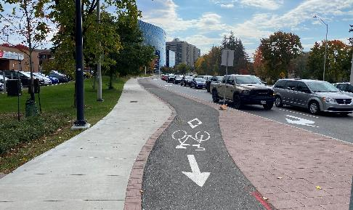
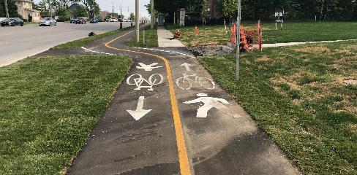
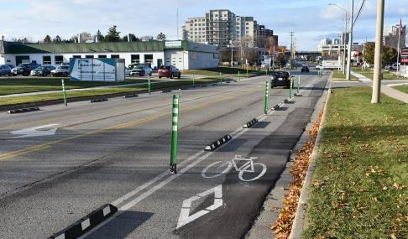
AT Facility Types
More Protection
Cycle Track
High Traffic Volumes + Speed
Tactile strip separates
pedestrian sidewalk and cycle track
Exclusively for cyclists
Physically Separated Bikeways
Horizontal and Vertical separation
Multi-use Path
Physically separated bikeways are cycling facilities designed for all ages and abilities that provide horizontal, and often vertical, separation from motor vehicle traffic.
Elements such as flexible bollards, curbs, concrete barriers, or guide rails, are used to create separation. These types of bikeways are typically applied on corridors with moderate to high traffic volumes and speeds.
They can be one-way or two-way travel corridors depending on the context.
Pathway is off-road
but within road right-
of-way
Shared space
Protected Bike Lane
Exclusively for cyclists
Physical barriers, like curbs and delineators, are used to enhance user safety
Moderate Traffic Volumes + Speed
10
Less Protection

Slide 11
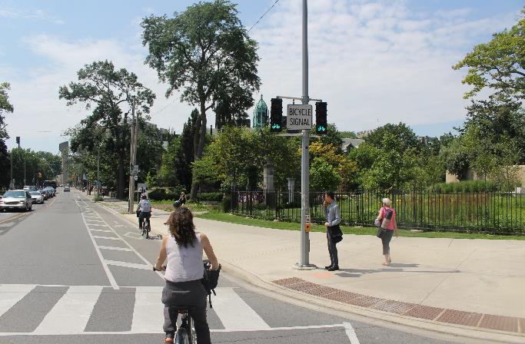
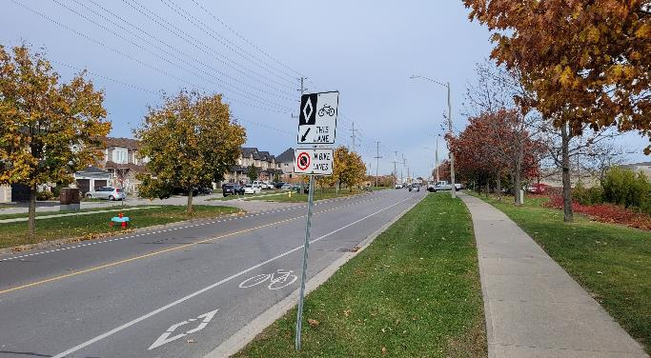
Designated Operating Space
More Protection
Buffered Bike Lanes
Moderate Traffic Volumes + Speed
Include a painted buffer for additional horizontal separation from motor vehicle lanes.
AT Facility Types
Exclusively for cyclists
Vertical separation only
Designated operating space refers to areas within the road right‑of‑way reserved exclusively for cyclists.
These facilities provide visual and spatial separation but no physical barriers from motor‑vehicle traffic.
Facilities that fall under this description are best suited to lower‑volume, lower‑speed roadways and one-way travel only.
One-way travel
Exclusively for cyclists
Conventional (Painted) Bike Lane
Marked with white
lines, painted symbols,
and signage.
Vertical separation only
One-way travel
Moderate to Low Volumes + Speed
11
Less Protection

Slide 12
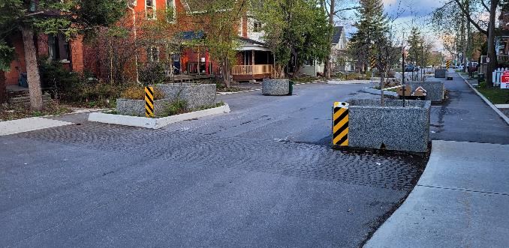
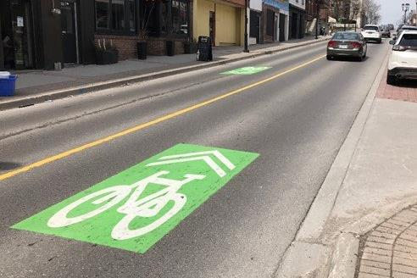
Shared Operating Space
Measures to slow
vehicles and/or reduce
vehicle volumes (traffic calming measures here)
More Protection
Shared space (no separation)
Prioritize bicycle movement > vehicles
AT Facility Types
Low/Reduced Traffic Volumes + Speed
Shared operating space refers to roadways where cyclists and motor vehicles use the same operating area with no physical changes to the roadway.
These conditions rely on very low motor‑vehicle volumes and speeds, where the likelihood of vehicle–cyclist passing events are minimal.
Facilities that fall under this description are generally limited to lower‑volume streets (local/residential) and rural roads and often incorporate traffic‑calming measures to support vehicle speed compliance.
Neighbourhood Greenway
Shared Street
Shared space (no separation)
Shared lane with green “sharrows” – a reminder this is a shared lane
Low Traffic Volumes + Speed and or residential
Unless otherwise restricted, cyclists are permitted on all roadways, regardless of signage.
Cyclists ride on the right of travel lane, unless space compromised
12
Less Protection

Slide 13
Proposed AT Facility Types
Facility Type | Total Length
Bike Lane | 20.5
Cycle Tracks | 2.1
Greenway | 38.8
Multi-use Path | 14.3
Multi-use Trail | 38.7
Separated Bike Lanes/Cycle Tracks | 41.5
Shared Roadway | 2.3
Total | 158.2
13

Slide 14
Facility Types – Urban Area
What We Heard – Key Themes from Mapping Comments:
Several locations noted as needing pedestrian/cyclist road crossings or network barrier crossings (Niagara River Parkway, Morrison Street, Welland River crossing at rail corridor)
General support for more dedicated or separated cycling facilities on busy roads
WWH: Dorchester Road Improvements; Support for more separated cycling facilities on busy streets
WWH: Drummond Street Improvements; Support for more separated cycling facilities on busy streets
WWH: Support for Morrison St. QEW crossover – prioritized NS & T Trail crossing to the North
WWH: Improved crossings at various locations
14

Slide 15
Facility Types - Downtown
WWH: Improved Zebra crossings at sidewalks along Portage Rd
WWH: Support Open Streets, like Clifton Hills
WWH: Need for improved pedestrian connections and crossings on major roads
15

Slide 16
Facility Types - Chippawa
WWH: Support for more separated cycling facilities on busy streets
16

Slide 17
Implementation
Prioritization Strategy
Based on two analyses: transportation need/equity and cycling potential
Transportation Need/Equity Indicators
  Unemployment
  Low income
  High school graduation
  Marginalization
  Post-secondary completion
  Municipal voting rate
  Community places
  Walkability
Cycling Potential Indicators
Population Density
Employment density
Density of young adults
Low motor vehicle ownership (0-1 per household)
Bicycle use (based on destination from TTS)
Short car trips (< 5km)
17

Slide 18
Equity Analysis and Cycling Potential Analysis Maps
18

Slide 19
Phasing Plan
Prioritization Strategy
Facility Type | Short-term Cost | Medium-term Cost | Long-term Cost | Total Cost
Bike Lane | $ 481,000.00 | $ 1,623,000.00 | $ 30,000.00 | $ 2,134,000.00
Cycle Tracks | $ 1,047,000.00 | $ - | $ - | $ 1,047,000.00
Greenway | $ 2,108,000.00 | $ 418,000.00 | $ - | $ 2,526,000.00
Multi-use Path | $ 2,055,000.00 | $ 620,000.00 | $ 2,679,000.00 | $ 5,354,000.00
Multi-use Trail | $ 4,110,000.00 | $ 6,254,000.00 | $ 4,242,000.00 | $ 14,606,000.00
Separated Bike Lanes/Cycle Tracks | $ 6,415,000.00 | $ 9,521,000.00 | $ 4,806,000.00 | $ 20,742,000.00
Shared Roadway | $ 3,000.00 | $ - | $ - | $ 3,000.00
Total | $ 16,219,000.00 | $ 18,436,000.00 | $ 11,757,000.00 | $ 46,412,000.00
19

Slide 20
Network Phasing Review – Urban Area
WWH: Support for additional crossings of the Welland River and QEW from Montrose Road to Chippawa Parkway
20
Notes:
Recommended policy for pedestrian/cyclist crossings at trail crossings of roadways, Provide dedicated pedestrian/cyclist signals or pedestrian crossovers (PXOs) at key locations in the network where trails cross busy roadways.
Dedicated crossings should be provided where trails cross collector or arterial roadways and a nearby alternative crossing is not available.
Accessibility features for intersections, recommended policy: Ensure that intersections support the use of mobility devices by introducing appropriate curb-cuts and tactile walking surface indicators (truncated domes) to improve access when entering/exiting an intersection.
Develop standards for using directional tactile walking surface indicators at intersections where appropriate.

Slide 21
Network Phasing - Downtown
21
Notes:
Recommended policy for accessible pedestrian walking speeds when determining pedestrian crossing times, Ensure that appropriate timing is used for pedestrian phases at signalized intersections. Use a walking speed of 1.0 m/s to calculate the pedestrian clearance interval. Consider using a slower walking speed of 0.8 m/s in areas with high volumes of pedestrians or crossings frequently used by young children or seniors.

Slide 22
Network Phasing - Chippawa
22
Notes:
WWH – the community supports several locations getting pedestrian/cyclist road crossings or network barrier crossings (Niagara River Parkway, Morrison Street, Welland River crossing at rail corridor)
Due to the
Nature of provincial jurisdiction over provincial highways – don’t allow parallel active transportation facilities within the highway right-of-way.
Topographic and water barriers – Welland river, hydro canal and the Niagara escarpment, all adding to the..
expensive nature of constructing standalone cycling infrastructure on major corridors,
Some proposed routes on major corridors will have to be planned for and implemented in the long-term as coordinated construction projects arise.
These long-term projects in the network include:
QEW crossing at NS&T Trail corridor
QEW and Hydro Canal crossings from Montrose Road to Dorchester Road
QEW and Welland River crossings from Montrose Road to Chippawa Parkway
Dedicated active transportation crossing over Falls Avenue parallel to Palmer Avenue, connecting the Olympic Torch Legacy Trail to Victoria Avenue

Slide 23
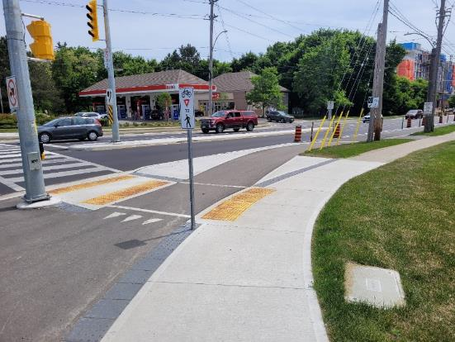
Network Policies: Safer Road Crossings
What We Heard is the desire for safer road crossings.
The TATMP recommends the following supportive policies:
Recommended policy for pedestrian/cyclist crossings at trail crossings of roadways
Recommended policy for accessibility features for intersections
Including safe intersections for Active Transportation – this including developing guidelines for the use of NRTOR and LPI/LBI
Recommended policy for accessible pedestrian walking speeds when determining pedestrian crossing times
Examples of accessibility features for intersections: Pedestrian Crossing of a Cycle Track at a Protected Intersection (Guelph, ON)
23

Slide 24
Wayfinding
24

Slide 25
Wayfinding Guidelines
Directional Signage
Used throughout the trail at regular intervals and intersections.
Provides reassurance that users are following the designated trail network.
Developed recommendations for the design of wayfinding signage – to be placed along the active transportation network to provide essential information to:
Help orient users themselves
Navigate from one location to another
Improves access to local destinations
Enhance tourism
Ensures safe use of transportation networks for everyone
Turn Signs
Indicates where an active transportation route turns from one street onto another.
Confirmation Signs
Identifies the current route of travel.
Reinforces direction after a turn.
Repeated regularly to indicate users are on a designated route.
25

Slide 26
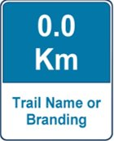
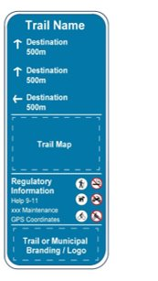
Wayfinding Guidelines Slide 2
Distance Markers
Placed incrementally along a trail.​​
Enhances user experience for exercise.​​
​Helps in emergencies when recorded with GPS and incorporated into digital maps.​
Wayfinding Guidelines
The final wayfinding approach and sign design will be developed as part of TATMP implementation.
Coordination with the City’s Recreation Department and their developing municipal wayfinding approach will be prioritized.
Trailhead Signs
Identify the primary trail access point
Provides directory of key information (destinations, point of contact for trail maintenance issues, regulatory info)
May include warnings about poisonous plants and trail ecology
26

Slide 27
Policies and Strategies
27
Notes:
Policies give us the clarity and direction needed to make aligned decisions, keeping focus on the Master Plan’s vision.
Strategies outline how we’ll move that vision forward with collaboration across various City teams

Slide 28
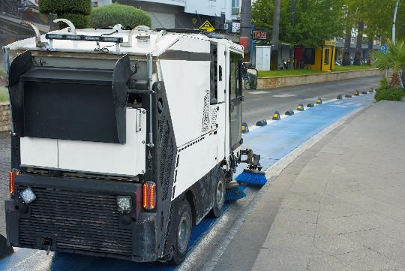
Maintenance Strategy
Winter Maintenance Strategy Options:
Winter maintenance of full network (recommended as best practice)
Designating Winter Priority Routes for snow clearing
Seasonal closures of routes with signage and notification
Winter maintenance strategy sets targets for routes to be maintained based on route type
Non-Winter Maintenance Policies:
Set targets for inspection frequency, sweeping frequency, state of disrepair
WWH: Develop a maintenance strategy for maintaining AT facilities. Recommended best practices for accessible maintenance targets.
28
Notes:
As we move into the implementation phase, maintenance becomes a critical part of ensuring the network is safe and reliable year‑round.
This was something we heard from the community at our previous public engagements.
Split into winter and non-winter maintenance policies and options
For non‑winter months, we’re proposing clear targets for how often routes are inspected, swept, and repaired so small issues don’t become bigger ones.
In the winter, we looked at several approaches. Best practice is to maintain the full network, but we also outline options such as establishing winter‑priority routes and using seasonal closures where appropriate.
The key message here is that winter maintenance targets are matched to route types, so the highest‑use corridors remain accessible and predictable for people walking and cycling.
Its important to note that the TATMP is recommending these strategies and not is not setting this as a prescriptive policy.
It will be on the city to implement these policies for maintenance, based on capacity and context, as the trails and AT network is built out and more connected.

Slide 29

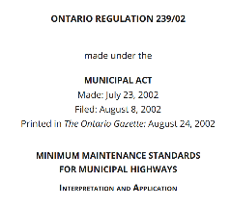
Maintenance Strategy – Non-winter Targets
Activity | Service Level Criteria
Patrol | Twice seasonally
Sweeping | Scheduled sweeping particularly in Spring and Fall, or during major construction activities; deploy resources outside of scheduled sweeping as soon as practicable Greater than 2cm after being aware of debris
Surface Discontinuities | 6.35 mm within 2 to 21 days after acquiring knowledge of the discontinuity
Signage and Pavement Markings | Refreshed as needed
Cracking | Greater than 12.7 mm wide and 6.35 mm deep
Potholes (on-road) | 2 cm deep within 4 days after acquiring knowledge of the pothole
Surface Drop-off at Shoulders | Deeper than 8 cm
Vegetation Management | Routine mowing including daylight triangles at intersections; annual trimming of bike path trees
29
Notes:
Here we break down what those non‑winter targets look like in practice. Based on minimum maintenance standards and best practices.
It’s important to note that to maintain different active transportation facilities, a combination of maintenance levels of service and context specific best practices are used to set clear targets for types and frequency of maintenance activities based on measurable criteria that indicate when infrastructure is in disrepair.
The Ontario Minimum Maintenance Standards (MMS) for Municipal Highways (Ontario Regulation 239/02, updated in 2018) sets targets for maintaining cycling facilities located within the roadway, such as bike lanes; however, targets for other types of cycling facilities remain as a gap in the MMS.
For example, multi-use paths are treated as sidewalks under MMS, but this does not reflect the differentiation between facility users; cyclists travel at higher speeds, which increases vulnerability and exposure to hazards.
Similarly, in-boulevard facilities like cycle tracks are not explicitly addressed in MMS, even though cyclists are more sensitive to surface conditions than pedestrians or drivers.
Ontario Traffic Manual (OTM) Book 18: Cycling Facilities encourages municipalities to set specific maintenance policies for cycling facilities, often exceeding MMS. Applying MMS without adjustment could result in facilities that meet legal standards but fail to provide safe, accessible conditions for cyclists.
So, as noted, when looking at some of these recommended non winter maintenance service levels, they are based on a combination of more context specific guidelines (like Book 18) and MMS
Patrols and sweeping are done regularly throughout the season, and issues like discontinuities or potholes have clear response timelines so they don’t linger.
Signage, markings, and vegetation are maintained proactively to support visibility and comfort.
Overall, these targets create a consistent, dependable experience for users throughout the warmer months

Slide 30
Maintenance Strategy – Winter Targets
Activity | Spine Route | Connector Route
Snow Clearing | Maintain to 2.5 cm within 8 hours | Maintain to 2.5 cm within 24 hours
Ice Treatment | Treat within 3 hours by 7 am and by 3pm on a weekday | Treat within 8 hours
Ice Prevention | Proactive anti-icing approach applied within 8 hours prior to a storm event | Proactive anti-icing approach applied within 24 hours prior to a storm event
30
Notes:
Winter maintenance is divided into two categories: spine routes and connector routes.
Spine routes are our highest‑priority corridors—these are cleared and treated more quickly because they see the greatest use.
Connector routes have slightly longer response times but still meet accessibility standards.
Across the board, we’re emphasizing proactive anti‑icing to reduce hazards and make winter trips more predictable.

Slide 31
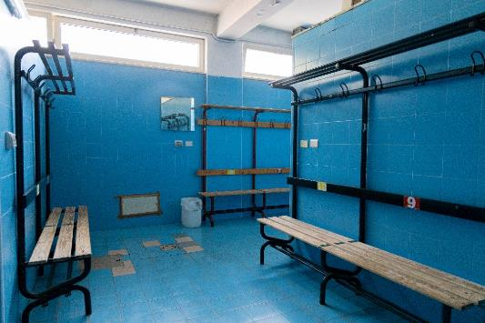
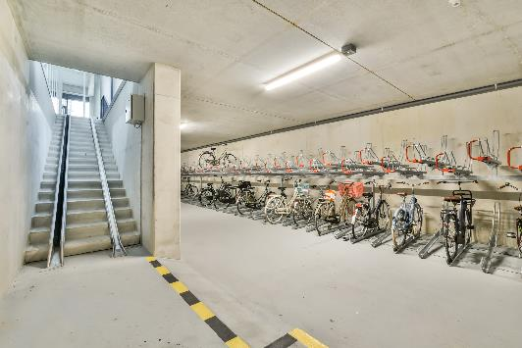
Amenities Policy
Amenities Placement
Placement based on “Amenity Hubs
Major Hubs: Located strategically at City facilities and properties where servicing exists
Minor Hubs: Located at key intersections of routes
Some amenities recommended to be placed frequently along routes
Example of minimum requirement at a major hub: washroom and potable water; bottom- long term bike parking )
Example of minimum requirement at a major hub: long term bike parking
31
Notes:
This section shifts into supporting more specific user needs and comfort.
We’re thinking not only about moving through the network but about what people need along the way to even consider using the network, as well as continue to use the network
The amenities policy organizes the network into major and minor hubs.
Major hubs—often at civic facilities where servicing already exists—provide essentials like washrooms, water, and secure parking
Minor hubs still offer important touchpoints, especially where routes intersect.
And along the routes themselves, strategically placed amenities help make longer trips more enjoyable and accessible.

Slide 32
Amenities Placement
Amenity | Major Hubs | Minor Hubs | Along Routes
Bike Parking (short-term) | · | ·
Bike Parking (long-term) | ·
Wayfinding | · | · | ·
Washrooms and potable water | · | °
Waste and recycling bins | · | ·
Rest Areas | · | · | ·
Lighting | · | · | ·
Amenities Policies
• = Minimum recommended ° = Additional amenities to consider
32
Notes:
This slide summarizes which amenities are recommended to be placed where.
You’ll see that some features, like bike parking, wayfinding, and lighting, are fundamental and appear at most locations.
Others, such as washrooms or water, are focused at major hubs where servicing is practical.
After hearing from the community, accessibility and safety feature such as recommending the inclusion of critical lighting at entrances, exits and intersections to pedestrian and cycling facilities
This tiered approach looks to balance amenities as both functional and cost‑effective

Slide 33
Amenities Policies Table
Amenity | Major Hubs | Minor Hubs | Along Routes
Climate protection | · | · | ·
Bicycle repair stands | · | °
Public Art | · | ° | °
Interpretive signs/displays | · | ° | °
Dedicated Mobility Device charging stations | · | · | °
Micromobility Device charging stations | · | °
Amenities Policies
Amenities Placement
• = Minimum recommended ° = Additional amenities to consider
33
Notes:
We also highlight amenities that can be perceived as “additional” that enhance the overall experience for users
These include things like public art, interpretive signage, repair stations, or mobility‑device charging.
These additions help make the network feel welcoming, inclusive, and responsive to a variety of user needs

Slide 34
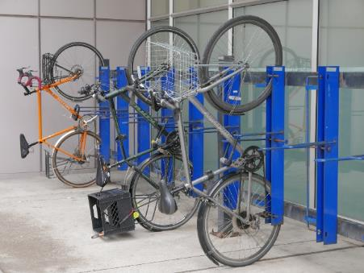
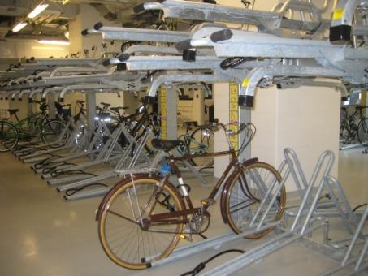
TDM Policy
Use | Bicycle parking rate
Multi-residential uses | 0.7 – 0.8 long-term spaces per unit 0.1 short-term spaces per unit Provide a minimum 5% of long-term spaces as accessible, no less than one
Commercial Uses | 1.0– 2.0 long-term spaces per 1,000m² (GFA) 2.0 short-term spaces per 1,000m² (GFA)
Office Uses | 1.0– 2.0 long-term spaces per 1,000m² (GFA) 1.0 – 2.0 short-term spaces per 1,000m² (GFA)
Industrial Uses | 0.5 – 1.0 long-term spaces per 1,000 m² (GFA)
Institutional Uses | 1.0– 1.5 long-term spaces per 1,000m² (GFA) 1.0 – 1.5 short-term spaces per 1,000m² (GFA)
Elementary/Secondary Schools | 0.6 – 1.0 long-term spaces per 1,000m² (GFA) 0.6 – 1.0 short-term spaces per 1,000m² (GFA)
Post-Secondary Schools | 6.0 – 10.0 long-term spaces per 1,000m² (GFA of offices & classrooms) 2.0 – 3.0 short-term spaces per 1,000m² (GFA of offices & classrooms)
Short-term: easy and in a convenient location for visitors., close to building entrances.
Examples of long-term bicycle parking
Long-term: secure and sheltered place, usually located within buildings and should be easy to access for cyclists.
34
Notes:
From amenities, we move into the Transportation Demand Management policies, known as TDM; encourage people to choose alternatives to driving alone by making walking, cycling, transit, and micromobility more convenient and attractive. In short, they help reduce car trips by influencing how, why, when, and where people travel, through incentives, programs, and supportive infrastructure.
Starting with bicycle parking in new developments. These rates as based on a jurisdictional scan of comparable municipalities and best practices
They reflect typical cycling patterns for different land uses—for example, higher parking needs at schools and post‑secondary institutions compared to say industrial uses.
This helps ensure that, as the built environment evolves, cycling remains a practical choice for residents, employees, and visitors.

Slide 35
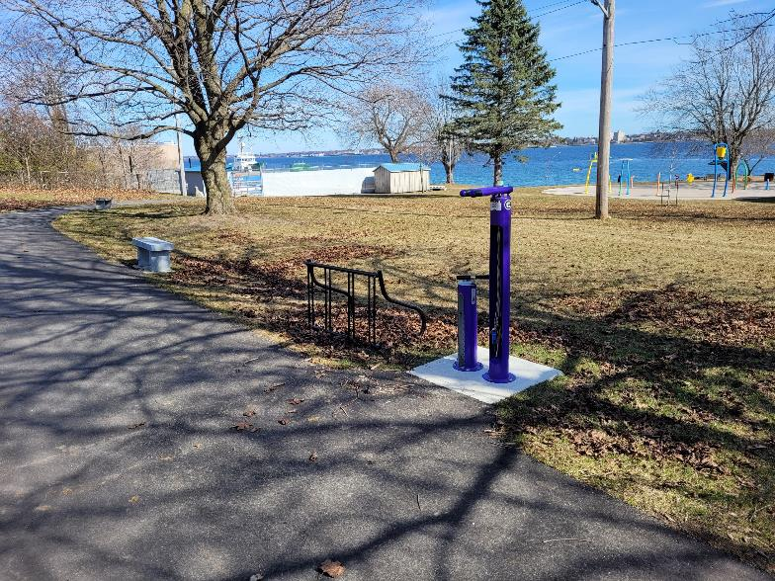
TDM Policy Slide 2
TDM Policy
50% of bike parking should be horizontal and, on the ground, to be more accessible.
Include other end-of-trip facilities in developments where there are 5 or more long-term spaces required:
Repair stations
Change rooms & showers (in non-residential uses)
Charging stations/outlets
Bike maintenance stations (washing)
Repair Station (pump and basic bicycle tools) along paved trail.
35
Notes:
These features reduce barriers for people who want to bike to school, work, or transit, and they help normalize cycling as an everyday transportation option

Slide 36
Programming
36
Notes:
Programs deliver the on‑the‑ground actions that support policies and strategies that the TATMP recommends.
It’s not enough to build infrastructure, as people need support, education, and opportunities to experience it.
Together, policies, strategies and programming will ensure that the TATMP moves from high‑level vision to measurable results
Informed by community and stakeholder input and leading practices from across North America, the next few slides will provide a few examples of the set of programs recommended in the TATMP
These programs are designed to build on the City’s existing assets and leverage established relationships to generate excitement and sustained support.

Slide 37
Active Transportation Responsibilities
Organization/Department | Typical Responsibilities*
Engineering | Design development and review
Planning & Development | Review of planning policies, review of planning applications for development requirements related to AT (ex: bike parking)
Transportation Services | AT transportation design review, AT network development, Internal and external agency coordination, School transportation, ATMP oversight
Recreation & Culture | Parks and trail design, promotion of active recreation
Municipal Works | Maintenance and associated budgeting and monitoring of AT facilities
RMN Transportation Planning | Planning of facilities for Regional Roads
RMN Public Health | AT health initiatives, active school travel, promotion
There are various responsibilities for implementing active transportation between various organizations and departments.
*Need to communicate to Council the additional responsibility and resources required by staff for implementation.
37
Notes:
There are various responsibilities for implementing active transportation between various organizations and departments.
Engineering, Planning, Transportation, Recreation, and Municipal Works all play different roles.
It’s important to note that implementation does require additional staff time and coordination, and that needs to be communicated
Regional partners also play a role, particularly on Regional Roads and through public health programming

Slide 38


Community Programming – Internal Program Initiatives
Cycle Toronto communications branding (Source: Cycle Toronto)
Communications Strategy
Supporting road safety initiatives:
  Traffic calming programs
  Vision Zero measures
Feasibility Study for Bike Share and Lending Program
Applying an equity lens to all recommended programming
In 2022, the City if Mississauga completed a Micro-Mobility Program Development Project, receiving council approval to develop a shared micro-mobility program in 2022 (Source: City of Mississauga)
38
Notes:
Internally, the City can lead or support several initiatives, ranging from:
Creating an internal public communications strategy - As the City begins to solidify its active transportation programming and education, having consistent and regular messaging is critical. A brand with City colors and associated graphics should be created and included on all promotional material used for any program or event put on by the City in relation to active transportation.
This will allow for a wider reach throughout the community, generating interest as the brand becomes more recognizable and established (see Cycle Toronto branding as an example at the top of the page here)
As well Vision Zeros measures (such as speed management programs and memorial programs to recognize lives lost to road way accidents)
There’s also an opportunity to study bike share or lending programs – through development projects like the City of Mississauga recently did in 2022.
A feasibility study would assess the viability, benefits, and challenges of introducing a bike share system within the community including community demand, financial considerations, operational models, environmental and health benefits and risk management and liability.
It’s important to consider prioritizing the application of an equity lens to all internal programming work, allowing the City to consider a variety of barriers individuals face to accessing mobility options in all initiatives
All of these initiatives help foster a culture of safety and support new users.

Slide 39
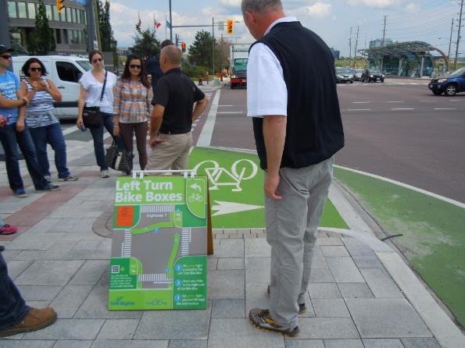
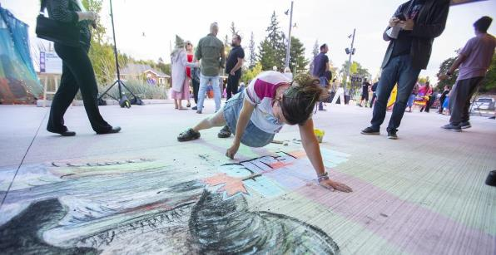
Community Programming – External Program Initiatives
Promotion of initiatives typically coordinated by external groups and supported/funded by City:
  Open Streets
  Public Awareness Campaigns
    Education for new infrastructure types (signage/info notices at facilities)
    Road Safety
Demonstration of left-turn bike boxes at a signalized intersection to improve cyclist safety and navigation (Source: York Region).
WWH: Support Open Streets, like Clifton Hill
Open Streets can support events like Niagara Falls Night of Art (Source: Niagara Falls Review, 2025)
39
Notes:
External initiatives often come from community groups or regional partners, with support from the City.
Open Streets - a community initiative where streets are temporarily closed to motor vehicles and transformed into pedestrian‑, cycling‑, and recreation‑friendly spaces. (ex at bottom)
These events often resemble large street fairs and are typically held on commercial main streets or other high‑traffic areas to support active transportation, local businesses, air quality, and community building
Safety campaigns: These initiatives aim to inform, educate, engage, and inspire the community to adopt active transportation and practice safe, respectful road-sharing behaviors. Campaigns may focus on increasing public understanding of active transportation, encouraging courteous conduct, promoting new infrastructure, or fostering community involvement
When possible, messaging should be co-developed with communities most impacted by mobility inequities, reflecting their lived experiences and priorities
It has been noted by key stakeholders that a campaign on road safety for all road users would be valuable to provide a clear break down of the rules of the road and promote a narrative that is grounded in mutual respect and safe behaviour for all road users across the City and Region.
These programs meet people where they are and help make the network feel safe, understandable, and inviting

Slide 40

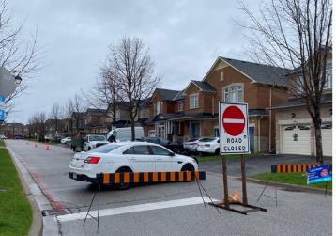
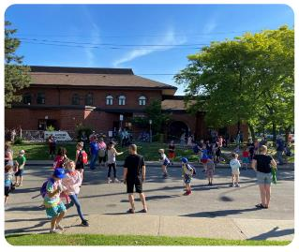
Active School Travel Program
WWH: Support AST Programming
Understanding that there are challenges with current active school travel practices around drop-off and pick-up.
Recommend reactivating and expanding the current ASTP with programming that prioritizes neighbourhood walkability. This should include:
School Streets: a pilot project that closes street to encourage safer streets around schools:
Permit street closures in front of schools
Pilot school streets with temporary materials: signs, traffic barrels, parked vehicles, etc.
Start small and scale up – initial pilot one or two days a week.
Campaigns (IWalk, Winter Walk Day, Spring into Spring) and events (Bike Week and Month)
School Streets (Source: Ontario School Streets Pilot Summary Report)
Winter Walk Day campaign ad (Source: Ontario Active School Travel, 2025).
40
Notes:
One specific program we wanted to highlight is active school travel programs – as it was specifically noted in previous public engagements by the community as something you all want to see implemented
Schools are a major opportunity to shift travel behaviour.
An Active School Travel Program (ASTP) is an initiative that promotes and supports children traveling to and from school using physically active modes of transportation. The program is designed to improve student health, enhance safety around schools, and reduce traffic congestion.
The program (ASTP) offers a clear framework, along with guidance and tools, to support schools and communities in working together to create and carry out customized School Travel Plans (STPs).
At a Regional level, Niagara School Transportation Services (NSTS) has worked with elementary schools throughout Niagara to promote Active School Travel through a variety of programming. This includes campaigns that promote walking and biking with a variety of celebratory events throughout all seasons
Since the COVID-19 pandemic, the ASTP has been less active in the Region, and a need and desire for programing that more intentionally incorporates and engages the surrounding neighbourhood to improve overall walkability for the community has become apparent.
The TATMP recommends that the City supports reactivating the ASTP programming already implemented by Niagara Region, prioritizing neighbourhood walkability as a key objective within new programming. This can be done by using their already established connections with Niagara Student Transportation Services and Public Health to locally expand on the Regions previously implemented ASTP programming, allowing for the surrounding neighbourhood to be more intentionally incorporated into the programming and benefits from its outcomes.
This should include:
School Streets—temporary closures around schools—are a proven way to improve safety and get families walking and cycling
Campaigns such as Winter Walk Day and Bike Month further support healthy, active travel habits for students

Slide 41
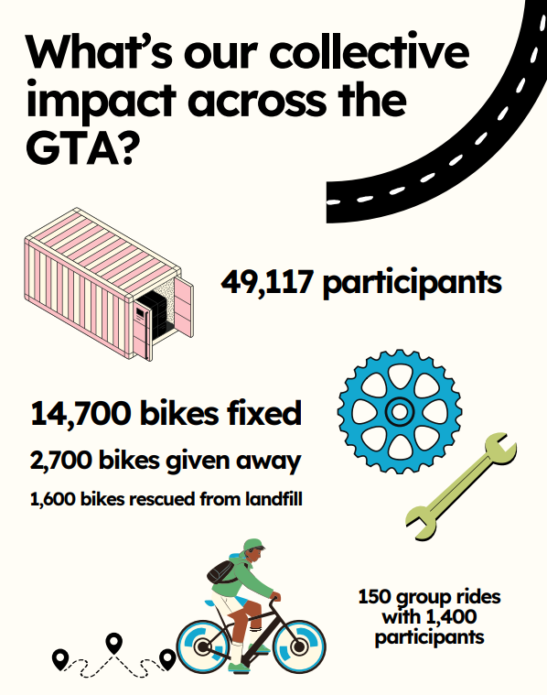
Education Initiatives
Recommend providing space at City facilities and events for enabling cycling. Support local organizations to implement these initiatives.
Community Bike Hubs: break down barriers for people both beginning and wanting to continue to cycle by offering:
Services: can include bike repairs (do-it-yourself and supported), rentals, secure bike parking and education (learn to ride, winter cycling tips etc.). All programming is mean to be offered for free or at a low cost.
Space: for local cycling clubs and advocacy groups to meet, plan and discuss events, store gear and collaborate with other like-minded groups.
Graphic excerpt from TCAT’s report on “Harnessing the power of community bike hubs” in the GTHA (Source: Toronto Centre for Active Transportation, 2023)
41
Notes:
Bike Hubs can act as essential community spaces that promote and support cycling, creating a welcoming and inclusive environment for cyclists and other rollers of all ages and abilities.
By supporting the creation of a Bike Hub, the capacity of local clubs, advocacy groups, community programs and individuals can be strengthened, allowing them to serve the community by encouraging and supporting relevant programming
Separate programming for equity-deserving communities should be developed and or supported, as creating dedicated spaces for these communities has been shown to enhance participation and engagement. This is mainly due to a greater sense of safety and shared understanding that these environments provide to the community

Slide 42
Monitoring and Reporting
42
Notes:
Lastly, I’ll touch on monitoring and reporting
Monitoring lets us understand how the network is performing over time.
It ensures we’re making data‑informed decisions and helps build accountability with both staff and the public.
Monitoring also supports long‑term planning, as trends emerge around usage, safety, and demand.

Slide 43
Monitoring Metric and Reporting
Program or Mechanism | Description | Method | Key Performance Indicators | Resources/ Similar Programs
Ex: Short-term Active Transportation Count Program | Manually collect and document cyclist and pedestrian activity within the City during the summer. | Manual counters should be at key destinations between May and August for 1-2 hour intervals per location | Cyclist and pedestrian counts (#) Percent of equity- deserving communities* who walk or bike (%) | Cyclist and Pedestrian Counts – Co-design the Active City Pedal Poll – Canada's National bicycle count
Establishing monitoring, evaluation and reporting programs is crucial for assessing the long-term success of an TATMP and ultimately determines if facilities and programs are achieving their intended goals or not.
Recommended Key performance indicators (KPIs): measure usage levels, safety outcomes, and user satisfaction. Regular monitoring helps establish a baseline and identify trends across the active transportation network.
Applying an equity lens: Monitor and report on systemic barriers and imbalances experienced by equity‑deserving groups in accessing and using the active transportation network and its infrastructure.
43
Notes:
Establishing monitoring, evaluation and reporting programs is crucial for assessing the long-term success of an TATMP and ultimately determines if facilities and programs are achieving their intended goals or not.
To do this the TATMP recommends a variety of monitoring programs or mechanisms with associated Key performance indicators (KPIs): which measure usage levels, safety outcomes, and user satisfaction. Regular monitoring helps establish a baseline and identify trends across the active transportation network.
Here we show an example KPI with its associated program or mechanism – go through table
It’s important to Apply an equity lens to KPI where possible: this allows for the City to monitor and report on systemic barriers and imbalances experienced by equity‑deserving groups in accessing and using the active transportation network and its infrastructure

Slide 44
Next Steps
Finalizing TATMP Report
Council presentation in April
Mathew Bilodeau | Nick Sully, P.Eng. , MSc.(Pl.)
Niagara Falls Project Manager E: mbilodeau@niagarafalls.ca | WSP TATMP Project Manager E: nick.sully@wsp.com
Project Webpage: | https://letstalk.niagarafalls.ca/tmp
44

Slide 45
Questions?
45

