Slide 1
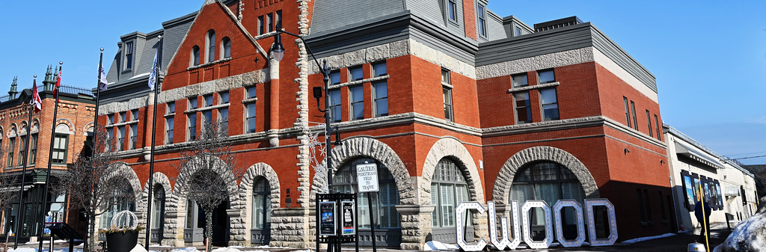
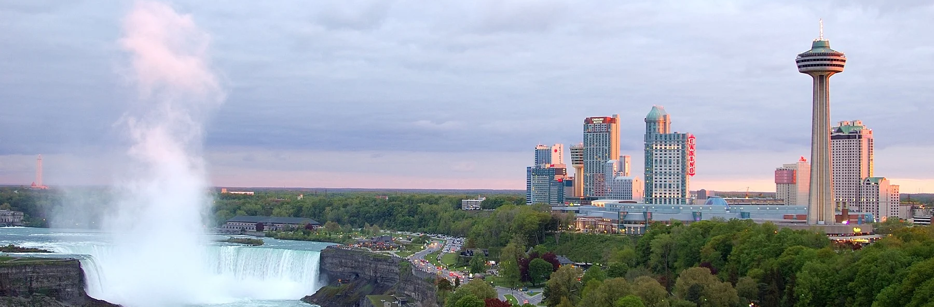

2024 Development Charges Study:
Draft DC Rates
Developer Information Session
    CITY OF NIAGARA FALLS
    March 4, 2024

Slide 2
Today We Will Discuss...
Background
Development Forecast
DC Capital Programs
Draft Calculated DC Rates
Rate Comparison
DC Policy Considerations
Next Steps

Slide 3
City’s Existing DC By-law 2019-69
By-law 2019-69 expires July 9, 2024
Includes development charges for the following services:
  General Government (studies), Library, Parks and Recreation, Public Works and Fleet, Roads and Related, Sidewalks, Storm, Water and Wastewater
Goal of the 2024 DC By-law update is to repeal the existing by-law and update the DC rates with new information
Draft development forecast, historical inventories and capital programs were presented to Council on February 27
  https://niagarafalls.civicweb.net/filepro/documents/68548/?preview=70529&attachmenturl=%2Fdocument%2F70473

Slide 4
Development Charges Study Process
Growth / Development Forecast
Amount, type and location of development
Growth-Related Capital Needs
What will we need to build?
15-Year Historical Service Levels
How much can be funded from DCs?
Operating and Replacement Cost Analysis, including Asset Management Plans – for information
Capital Needs Eligible to be funded from DCs
Remainder funded from other sources
Legislated Reductions
Grants, other contributions, benefit to existing, available DC reserves, post-period benefit
Costs Eligible for DC Recovery
Residential Sector
(per unit)
Non-Residential Sector
(per m² of GFA)

Slide 5
Development Forecast Considerations
Informed by Niagara Region MCR, forecasts prepared as part of ongoing Master Plan work and Council endorsed housing pledge
  City has initiated its Official Plan review
15-year Historical planning period – 2009-2023
Future planning periods:
  2024-2033 – General Services and Engineered Services

Slide 6
Development Forecast: City-wide
Historical Growth
2006-2021
Forecast Growth
2024-2033
Note: Census Population exclude Census undercoverage, Place of Work (POW) Employment, excludes work at home employment

Slide 7
Development Forecast: Area-Specific
Core Tourist Area/Outside Core Tourist Area

Slide 8
Summary 15-Year Historical Service Levels and
Maximum Funding Envelopes
Service | Measure | Historical Average Service Level | Planning Horizon | Maximum Permissible Funding Envelope | Funding Envelope Exceeded?
Library Services | $/capita | $703.82 | 10-years | $11.2 million | No
Fire Protection | $/capita + employee | $589.36 | 10-years | $13.1 million | No
Parks & Recreation | $/capita | $4,053.86 | 10-years | $64.6 million | No
Public Works & Fleet | $/capita + employee | $427.75 | 10-years | $9.5 million | Yes
Roads* | $/capita + employee | $9,005.40 | 10-years | $200.9 million | No
* Includes sidewalks
DCA now requires a 15-year historical service level
No service level is provided for water/wastewater infrastructure as standards are required by other legislation

Slide 9
Growth-Related Capital Programs
Capital programs have been informed by:
  Previous DC Background Study
  2024 Capital Budget
  Preliminary data from ongoing Master Servicing Plan Update
  Discussions with staff
DC eligible costs adjusted for:
  Grants, subsidies and other contributions
  “Benefit to existing” or replacement elements
  Available DC reserve funds
  “Post Period” benefits

Slide 10
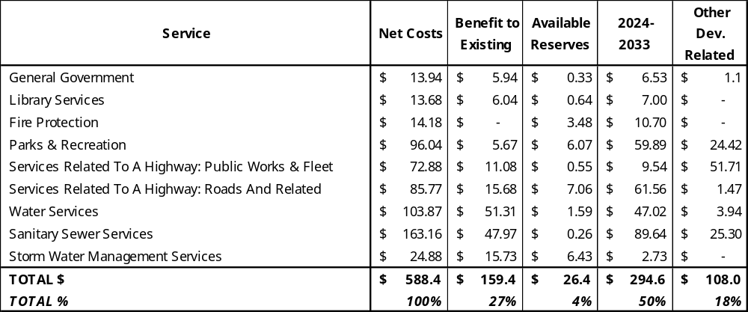
Summary of Capital Program (in Millions): 2024-2033

Slide 11
Draft Development Charges Calculation
Draft development charges represent maximum permissible rates calculated under the Development Charges Act
Residential rates are based on the following unit types:
  Single and Semi-Detached
  Rows and Other Multiples
  Apartments
  Special Care Needs – NEW (aligns with Region)
Non-residential rates have been calculated by differentiated area, consistent with the previous study
  Core Tourist Area
  Outside Core Tourist Area

Slide 12
Fully Calculated Draft Residential Charges
$/Unit
Single/Detached $39,647
Rows & Multiples $27,303
Apartments $19,673
Special Care Needs $12,022

Slide 13
Calculated vs Current Rates Over 5-Year Phase-In
$/Single-Detached Unit | Calculated | Change (%)
Current | $17,239
Year 1 - 2024 (80%) | $31,718 | 84%
Year 2 - 2025 (85%) | $33,700 | 6%
Year 3 - 2026 (90%) | $35,682 | 6%
Year 4 - 2027 (95%) | $37,665 | 6%
Year 5 - 2028 (100%) | $39,647 | 5%
DCA requires DC rates to be phased-in over 5-years
Rate increase due to:
  Fulsome capital program update
  Updates to development forecast
  Inclusion of new Secondary Plan Areas and associated projects
DCs are frozen at site plan or rezoning (if applicable)

Slide 14
Residential Rate Comparison ($/Single Detached Unit)
Note: Year (XXX) represents the year the DC By-law was implemented

Slide 15
Fully Calculated Draft Non-Residential Rates
Core Tourist Area/Outside Core Tourist Area
Core Tourist Area
$139.78/m2 or $13.00/sf
Outside Core Tourist Area
$139.68/m2 or $12.98/sf

Slide 16
Calculated vs Current Rates Over 5-Year Phase-In
$/OCTA | Calculated $/m2 | Calculated $/sf | Change (%)
Current | $57.26 | $5.32
Year 1 - 2024 (80%) | $111.82 | $10.39 | 95%
Year 2 - 2025 (85%) | $118.81 | $11.04 | 6%
Year 3 - 2026 (90%) | $125.80 | $11.69 | 6%
Year 4 - 2027 (95%) | $132.79 | $12.34 | 6%
Year 5 - 2028 (100%) | $139.78 | $13.00 | 5%
DCA requires DC rates to be phased-in over 5-years
Rate increase due to:
  Fulsome capital program update
  Updates to development forecast
  Inclusion of new Secondary Plan Areas and associated projects
DCs are frozen at site plan or rezoning (if applicable)
$/CTA | Calculated $/m2 | Calculated $/sf | Change (%)
Current | $33.68 | $3.13
Year 1 - 2024 (80%) | $111.75 | $10.38 | 232%
Year 2 - 2025 (85%) | $118.73 | $11.03 | 6%
Year 3 - 2026 (90%) | $125.72 | $11.68 | 6%
Year 4 - 2027 (95%) | $132.70 | $12.33 | 6%
Year 5 - 2028 (100%) | $139.68 | $12.98 | 5%

Slide 17
Commercial Rate Comparison ($/Square Metre)
Core Tourist Area
Outside Core Tourist Area
Note: Year (XXX) represents the year the DC By-law was implemented

Slide 18
DC Policy Considerations
Recommend new Industrial Grant Program
  100% exemption currently provided for industrial development
  Establish program outside of DC By-law, can be capped/changed outside of DC by-law
Recommend CIP Policies be external to DC By-law
  Reference CIP policies rather than include exemption directly in by-law
  Allow for changes to DC exemptions outside of by-law update
Other Policy Considerations
  Add exemption for places of worship
  Add DC rate for Special Care/Special Needs Dwellings
  Review area-specific rates for the Core Tourist Area/Outside Core Tourist Area
  Allow DCs to be deferred and payable upon occupancy instead of building permit
Requirements of DCA
  Council can choose to discount or implement lower DC rates but will require funding from non-DC revenue sources (e.g. property taxes and/or utility rates)

Slide 19
Proposed DC Study Timeline – Key Dates
Item | Date /Comments
Council Information Session | February 27th 2024
Developer Consultation | March 4th, 2024
Prepare Draft DC Background Study | February/March 2024
Release DC Background Study to Public | March 28th, 2024 or earlier (60 days before DC By-law)
Notice of Public Meeting | April 10th, 2024 (20 days before meeting)
Statutory Public Meeting | April 30th, 2024
DC By-law Passage | May 28th, 2024
Notice of By-law Passage | June 2024
Appeal Period | 40 days after DC By-law passage

Slide 20
Questions?

Slide 21
Additional Slides for Discussion

Slide 22
